Slide 1
Exploring Generative Adversarial Networks(GANs) CSE4019 - IMAGE PROCESSING J-component Guided By: Dr. S. Geetha
By
19BCE1215 – Felicia Sharon
19BCE1508 - Rupali Tripathi
19BCE1532 - Hima Rani Mathews

Slide 2
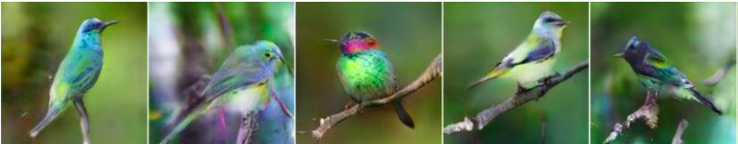
AIM
1) Text to Image Generation using StackGAN
In this project we will explore 2 types of GAN for 2 different types of applications. The first type of application is using StackGAN to generate 256×256 photo-realistic images conditioned on text descriptions.
(Text Input): The bird is black with green and has a very short beak
(Output — Generated photo-realistic images):

Slide 3
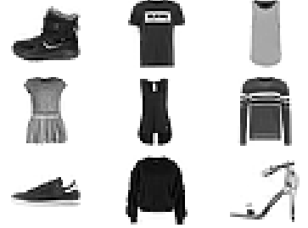
AIM
2) Solving class imbalance using SGAN
The second type is using a Semi-supervised GAN to generate image samples of the imbalanced 28*28 image dataset (Fashion-mnist). The goal of this approach is to solve class imbalance in an image dataset and to use knn as the criteria to add samples to the dataset. The balanced dataset will also be compared to that of the one made by SMOTE approach by building a decision tree classifier on them and comparing their accuracies.

Slide 4
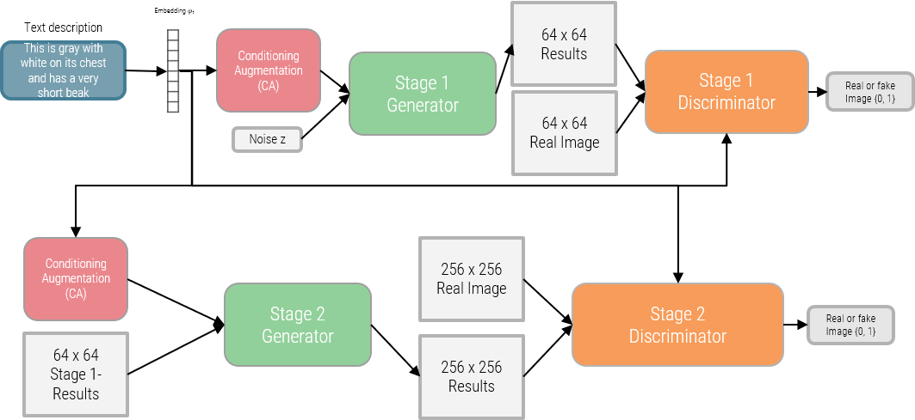
Stack GAN

Slide 5
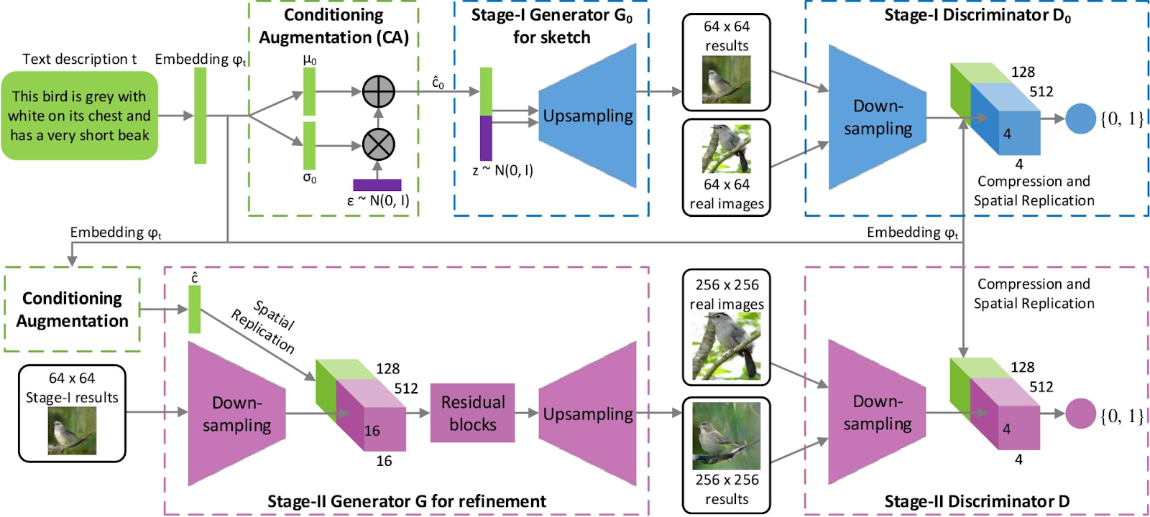

Slide 6
Semi-supervised GAN (SGAN)
The semi-supervised GAN, or SGAN, model is an extension of the GAN architecture that involves the simultaneous training of a supervised discriminator, unsupervised discriminator, and a generator model. The result is both a supervised classification model that generalizes well to unseen examples and a generator model that outputs plausible examples of images from the domain.
The discriminator in a traditional GAN is trained to predict whether a given image is real (from the dataset) or fake (generated), allowing it to learn features from unlabeled images. The discriminator can then be used via transfer learning as a starting point when developing a classifier for the same dataset, allowing the supervised prediction task to benefit from the unsupervised training of the GAN.

Slide 7
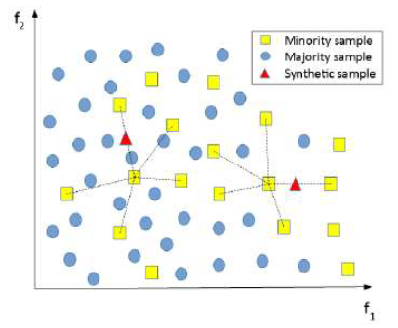

SMOTE
Synthetic Minority Oversampling Technique (SMOTE) aims to create "synthetic" examples based on original samples instead of adding replicated ones to the minority class. SMOTE generates samples according to the similarities among existing minority instances. For specific feature sample xi in a feature set S, SMOTE and the K-nearest neighbors of xi in the feature space. To generate a synthetic sample, one of these K-nearest neighbors is randomly selected, then calculate the euclidean distance between these two samples, and at last add the multiplication result of the distance with a random number between [0,1] to the original feature instance:

Slide 8
IMPLEMENTATION

Slide 9
1. Text to image translation using Stack-GAN
Downloading the CUB_200_2011 dataset.
Number of categories: 200
Number of images: 11,788
Downloading the text descriptions of birds of each class
Downloading word-to-vec (pretrained model to convert text to 256 dimension vector of real numbers) embeddings of those text.
Implementing Stage1 of the stack gan model
Storing the results obtained from them
Implementing Stage2 of the stack gan model by using the stage1 output images
Storing the final received images .

Slide 10
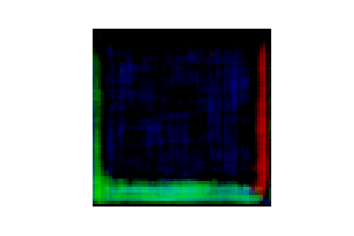
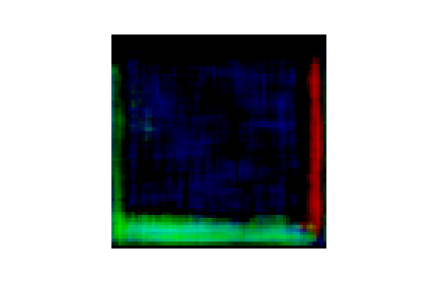
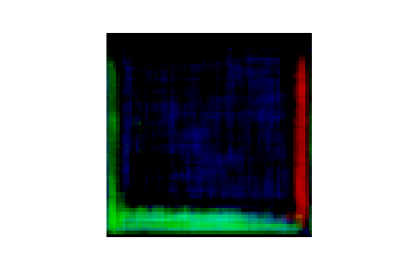
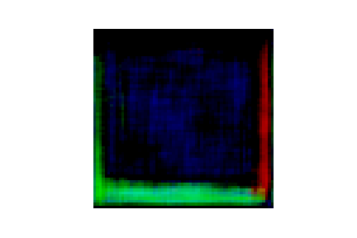
Stage 1 RESULTS

Slide 11
2. Solving class imbalance using SGAN
Load the dataset Fashion-mnist
Since Fashion-mnist is a balanced dataset with each class having 7000 records, they will be manually made imbalanced by removing some samples
Build a KNN model on the imbalanced dataset
The SGAN model is built and the generated image samples are added based on the KNN model criteria
After the dataset is made balanced, decision tree model is built on it and the accuracy is found

Slide 12
3. Solving class imbalance using SMOTE
The same pre-processing procedure is followed as with SGAN
SMOTE is used to make the imbalanced dataset into a balanced dataset
After the dataset is made balanced, decision tree model is built on it and the accuracy is found

Slide 13
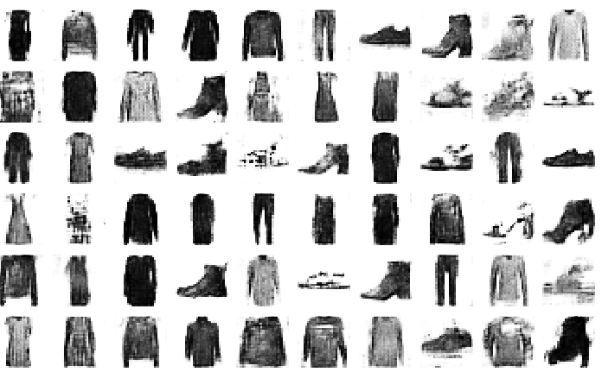
Semi-supervised GAN

Slide 14
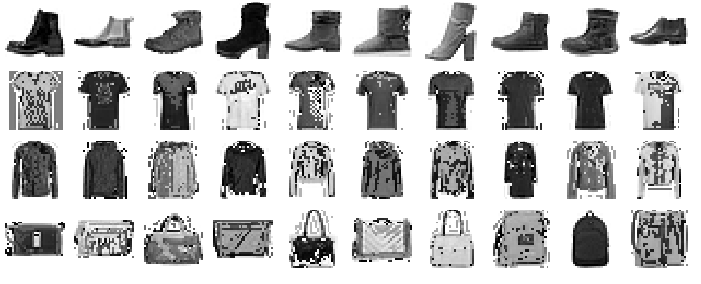
SMOTE

Slide 15
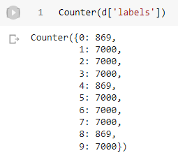
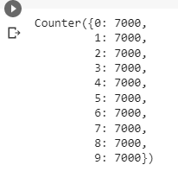
RESULTS
Imbalanced Fashion dataset
Balanced Fashion dataset

Slide 16


Comparison of SGAN and SMOTE w.r.t Decision Tree classifier
SGAN
SMOTE

Slide 17
THANK YOU

